Slide 1
Measuring a Nation’s Income
© 2012 Cengage Learning. All Rights Reserved. May not be copied, scanned, or duplicated, in whole or in part, except for use as permitted in a license distributed with a certain product or service or otherwise on a password-protected website for classroom use.

Slide 2
Economics
Microeconomics
  Study of how households and firms
    Make decisions
    Interact in markets
Macroeconomics
  Study of economy-wide phenomena
    Including inflation, unemployment, and economic growth
© 2012 Cengage Learning. All Rights Reserved. May not be copied, scanned, or duplicated, in whole or in part, except for use as permitted in a license distributed with a certain product or service or otherwise on a password-protected website for classroom use.

Slide 3
Economy’s Income & Expenditure
Gross Domestic Product (GDP)
  Measures the total income of everyone in the economy
  Measures the total expenditure on the economy’s output of goods and services
For an economy as a whole
  Income must equal expenditure
© 2012 Cengage Learning. All Rights Reserved. May not be copied, scanned, or duplicated, in whole or in part, except for use as permitted in a license distributed with a certain product or service or otherwise on a password-protected website for classroom use.

Slide 4
Economy’s Income & Expenditure
Circular-flow diagram – assumptions:
  Markets
    Goods and services
    Factors of production
  Households
    Spend all of their income
    Buy all goods and services
  Firms
    Pay wages, rent, profit to resource owners
© 2012 Cengage Learning. All Rights Reserved. May not be copied, scanned, or duplicated, in whole or in part, except for use as permitted in a license distributed with a certain product or service or otherwise on a password-protected website for classroom use.

Slide 5
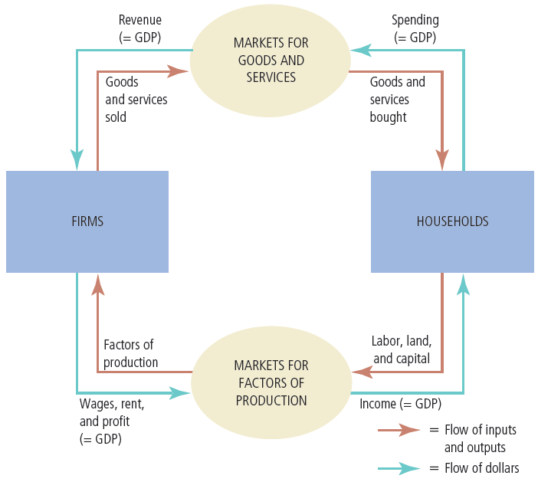
Figure 1
The Circular-Flow Diagram
Households buy goods and services from firms, and firms use their revenue from sales to pay wages to workers, rent to landowners, and profit to firm owners. GDP equals the total amount spent by households in the market for goods and services. It also equals the total wages, rent, and profit paid by firms in the markets for the factors of production.
© 2012 Cengage Learning. All Rights Reserved. May not be copied, scanned, or duplicated, in whole or in part, except for use as permitted in a license distributed with a certain product or service or otherwise on a password-protected website for classroom use.

Slide 6
The Measurement of GDP
Gross domestic product (GDP)
  Market value of all final goods and services
  Produced within a country
  In a given period of time
“GDP is the market value…”
  Market prices - reflect the value of the goods
© 2012 Cengage Learning. All Rights Reserved. May not be copied, scanned, or duplicated, in whole or in part, except for use as permitted in a license distributed with a certain product or service or otherwise on a password-protected website for classroom use.

Slide 7
The Measurement of GDP
“… of all…”
  All items produced in the economy
    And sold legally in markets
  Excludes most items
    Produced and sold illicitly
    Produced and consumed at home
© 2012 Cengage Learning. All Rights Reserved. May not be copied, scanned, or duplicated, in whole or in part, except for use as permitted in a license distributed with a certain product or service or otherwise on a password-protected website for classroom use.

Slide 8
The Measurement of GDP
“… final…”
  Value of intermediate goods is already included in the prices of the final goods
“… goods and services…”
  Tangible goods & intangible services
“… produced…”
  Goods and services currently produced
© 2012 Cengage Learning. All Rights Reserved. May not be copied, scanned, or duplicated, in whole or in part, except for use as permitted in a license distributed with a certain product or service or otherwise on a password-protected website for classroom use.

Slide 9
The Measurement of GDP
“… within a country…”
  Goods and services produced domestically
    Regardless of the nationality of the producer
“… in a given period of time”
  A year or a quarter
© 2012 Cengage Learning. All Rights Reserved. May not be copied, scanned, or duplicated, in whole or in part, except for use as permitted in a license distributed with a certain product or service or otherwise on a password-protected website for classroom use.

Slide 10
The Components of GDP
Y = C + I + G + NX
  Identity
  Y = GDP
  C = consumption
  I = investment
  G = government purchases
  NX = net exports
© 2012 Cengage Learning. All Rights Reserved. May not be copied, scanned, or duplicated, in whole or in part, except for use as permitted in a license distributed with a certain product or service or otherwise on a password-protected website for classroom use.

Slide 11
The Components of GDP
Consumption, C
  Spending by households on goods and services
  Exception: purchases of new housing
Investment, I
  Spending on capital equipment, inventories, and structures
  Household purchases of new housing
  Inventory accumulation
© 2012 Cengage Learning. All Rights Reserved. May not be copied, scanned, or duplicated, in whole or in part, except for use as permitted in a license distributed with a certain product or service or otherwise on a password-protected website for classroom use.

Slide 12
The Components of GDP
Government purchases, G
  Government consumption expenditure and gross investment
  Spending on goods and services
  By local, state, and federal governments
  Does not include transfer payments
© 2012 Cengage Learning. All Rights Reserved. May not be copied, scanned, or duplicated, in whole or in part, except for use as permitted in a license distributed with a certain product or service or otherwise on a password-protected website for classroom use.

Slide 13
The Components of GDP
Net exports, NX = Exports - Imports
  Exports
    Spending on domestically produced goods by foreigners
  Imports
    Spending on foreign goods by domestic residents
© 2012 Cengage Learning. All Rights Reserved. May not be copied, scanned, or duplicated, in whole or in part, except for use as permitted in a license distributed with a certain product or service or otherwise on a password-protected website for classroom use.

Slide 14
The components of U.S. GDP
2009, GDP of the U.S. = $14 trillion
GDP per person = $46,372
  Consumption = $32,823 per person
  Investment = $5,278 per person
  Government purchases = $9,540 per person
  Net exports = –$1,269 per person
© 2012 Cengage Learning. All Rights Reserved. May not be copied, scanned, or duplicated, in whole or in part, except for use as permitted in a license distributed with a certain product or service or otherwise on a password-protected website for classroom use.

Slide 15
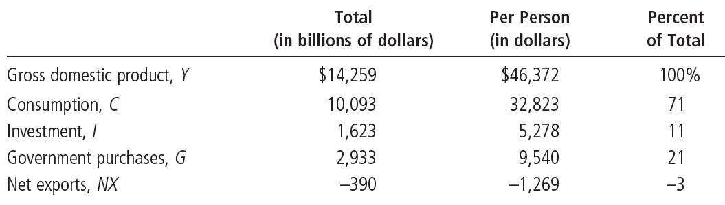
Table 1
GDP and Its Components
This table shows total GDP for the U.S. economy in 2009 and the breakdown of GDP among its four components. When reading this table, recall the identity
Y = C + I + G + NX.
© 2012 Cengage Learning. All Rights Reserved. May not be copied, scanned, or duplicated, in whole or in part, except for use as permitted in a license distributed with a certain product or service or otherwise on a password-protected website for classroom use.

Slide 16
Real versus Nominal GDP
Total spending rises from one year to the next
  Economy - producing a larger output of goods and services
  And/or goods and services are being sold at higher prices
Nominal GDP
  Production of goods and services
  Valued at current prices
© 2012 Cengage Learning. All Rights Reserved. May not be copied, scanned, or duplicated, in whole or in part, except for use as permitted in a license distributed with a certain product or service or otherwise on a password-protected website for classroom use.

Slide 17
Real versus Nominal GDP
Real GDP
  Production of goods and services
  Valued at constant prices
  Designate one year as base year
  Not affected by changes in prices
For the base year
  Nominal GDP = Real GDP
© 2012 Cengage Learning. All Rights Reserved. May not be copied, scanned, or duplicated, in whole or in part, except for use as permitted in a license distributed with a certain product or service or otherwise on a password-protected website for classroom use.

Slide 18
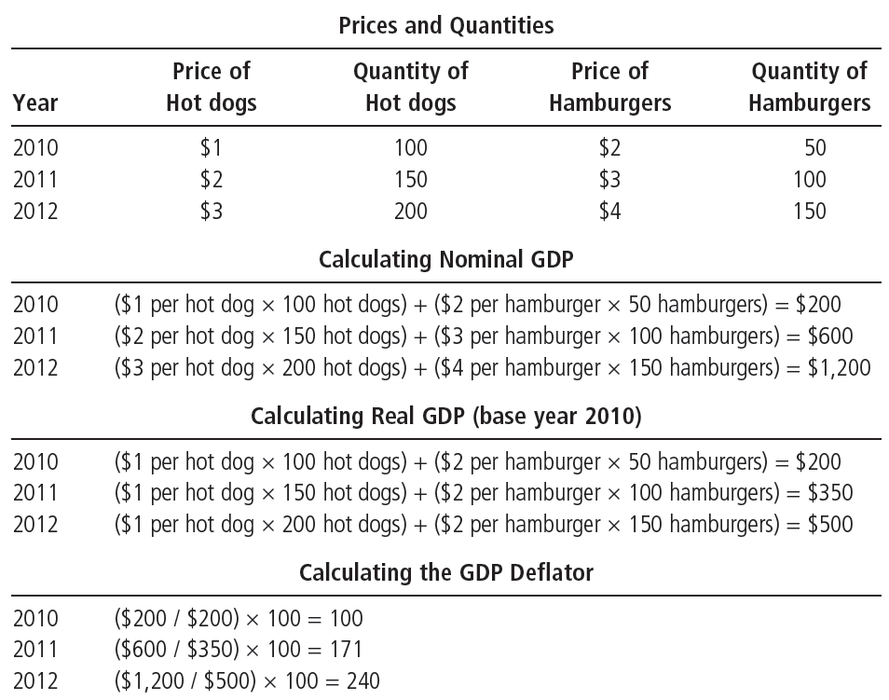
Table 2
Real and Nominal GDP
This table shows how to calculate real GDP, nominal GDP, and the GDP deflator for a hypothetical economy that produces only hot dogs and hamburgers.
© 2012 Cengage Learning. All Rights Reserved. May not be copied, scanned, or duplicated, in whole or in part, except for use as permitted in a license distributed with a certain product or service or otherwise on a password-protected website for classroom use.

Slide 19
Real versus Nominal GDP
The GDP deflator
  Ratio of nominal GDP to real GDP times 100
  Is 100 for the base year
  Measures the current level of prices relative to the level of prices in the base year
  Can be used to take inflation out of nominal GDP (“deflate” nominal GDP)
© 2012 Cengage Learning. All Rights Reserved. May not be copied, scanned, or duplicated, in whole or in part, except for use as permitted in a license distributed with a certain product or service or otherwise on a password-protected website for classroom use.

Slide 20
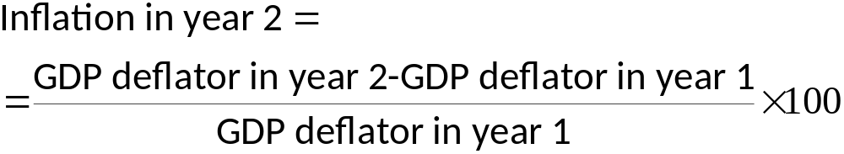
Real versus Nominal GDP
Inflation
  Economy’s overall price level is rising
Inflation rate
  Percentage change in some measure of the price level from one period to the next
© 2012 Cengage Learning. All Rights Reserved. May not be copied, scanned, or duplicated, in whole or in part, except for use as permitted in a license distributed with a certain product or service or otherwise on a password-protected website for classroom use.

Slide 21
Real GDP over recent history
The GDP data
  Real GDP grows over time
  Growth – average 3% per year since 1965
  Growth is not steady
    GDP growth interrupted by recessions
© 2012 Cengage Learning. All Rights Reserved. May not be copied, scanned, or duplicated, in whole or in part, except for use as permitted in a license distributed with a certain product or service or otherwise on a password-protected website for classroom use.

Slide 22
Real GDP over recent history
Recession
  Two consecutive quarters of falling GDP
  Real GDP declines
  Lower income
  Rising unemployment
  Falling profits
  Increased bankruptcies
© 2012 Cengage Learning. All Rights Reserved. May not be copied, scanned, or duplicated, in whole or in part, except for use as permitted in a license distributed with a certain product or service or otherwise on a password-protected website for classroom use.

Slide 23
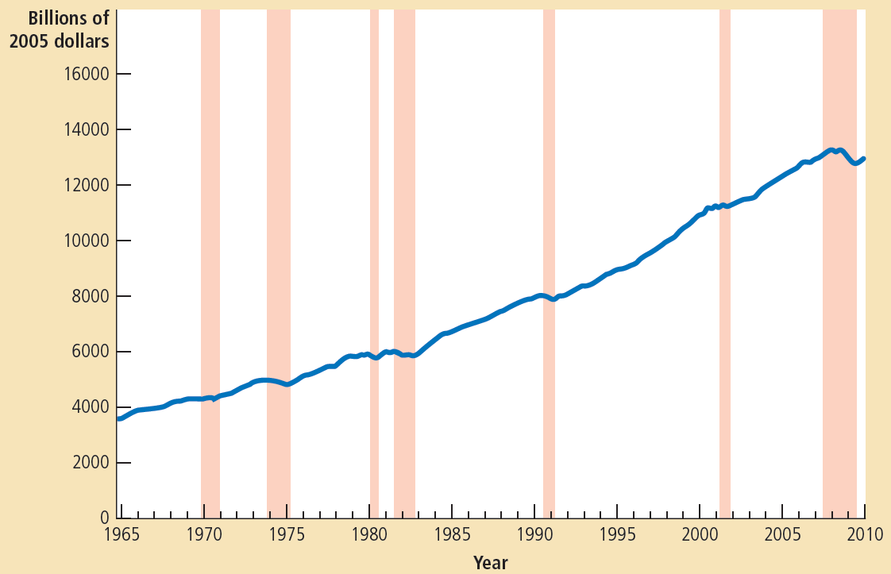
Figure 2
Real GDP in the United States
This figure shows quarterly data on real GDP for the U.S. economy since 1965. Recessions—periods of falling real GDP—are marked with the shaded vertical bars.
© 2012 Cengage Learning. All Rights Reserved. May not be copied, scanned, or duplicated, in whole or in part, except for use as permitted in a license distributed with a certain product or service or otherwise on a password-protected website for classroom use.

Slide 24
GDP
GDP – “the best single measure of the economic well-being of a society”
  Economy’s total income
  Economy’s total expenditure
  Larger GDP
    Good life, better healthcare
    Better educational systems
  Measure our ability to obtain many of the inputs into a worthwhile life
© 2012 Cengage Learning. All Rights Reserved. May not be copied, scanned, or duplicated, in whole or in part, except for use as permitted in a license distributed with a certain product or service or otherwise on a password-protected website for classroom use.

Slide 25
GDP
GDP – not a perfect measure of well-being
  Doesn’t include
    Leisure
    Value of almost all activity that takes place outside markets
    Quality of the environment
  Nothing about distribution of income
© 2012 Cengage Learning. All Rights Reserved. May not be copied, scanned, or duplicated, in whole or in part, except for use as permitted in a license distributed with a certain product or service or otherwise on a password-protected website for classroom use.

Slide 26
International differences: GDP & quality of life
Rich countries - higher GDP per person
  Better
    Life expectancy
    Literacy
    Internet usage
Poor countries - lower GDP per person
  Worse
    Life expectancy
    Literacy
    Internet usage
© 2012 Cengage Learning. All Rights Reserved. May not be copied, scanned, or duplicated, in whole or in part, except for use as permitted in a license distributed with a certain product or service or otherwise on a password-protected website for classroom use.

Slide 27
International differences: GDP & quality of life
Low GDP per person
  More infants with low birth weight
  Higher rates of infant mortality
  Higher rates of maternal mortality
  Higher rates of child malnutrition
  Less common access to safe drinking water
  Fewer school-age children are actually in school
© 2012 Cengage Learning. All Rights Reserved. May not be copied, scanned, or duplicated, in whole or in part, except for use as permitted in a license distributed with a certain product or service or otherwise on a password-protected website for classroom use.

Slide 28
International differences: GDP & quality of life
Low GDP per person
  Fewer teachers per student
  Fewer televisions
  Fewer telephones
  Fewer paved roads
  Fewer households with electricity
© 2012 Cengage Learning. All Rights Reserved. May not be copied, scanned, or duplicated, in whole or in part, except for use as permitted in a license distributed with a certain product or service or otherwise on a password-protected website for classroom use.

Slide 29
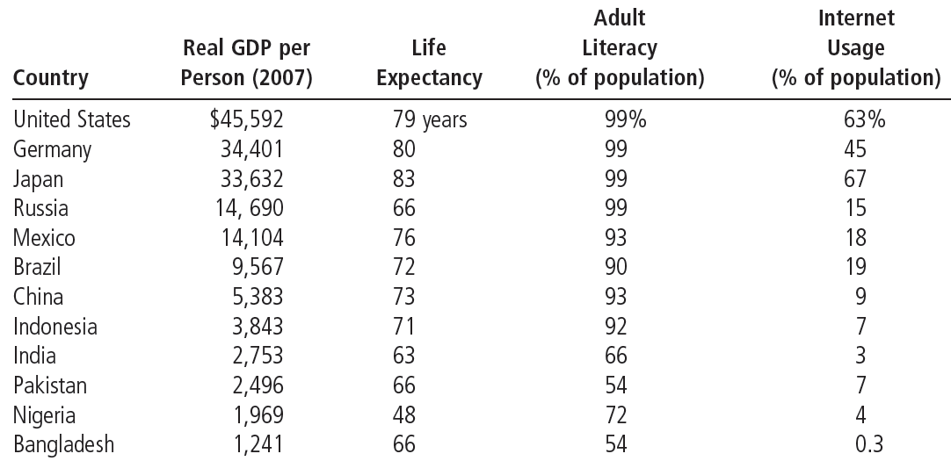
Table 3
GDP and the Quality of Life
The table shows GDP per person and three other measures of the quality of life for twelve major countries.
© 2012 Cengage Learning. All Rights Reserved. May not be copied, scanned, or duplicated, in whole or in part, except for use as permitted in a license distributed with a certain product or service or otherwise on a password-protected website for classroom use.

